Slide 1
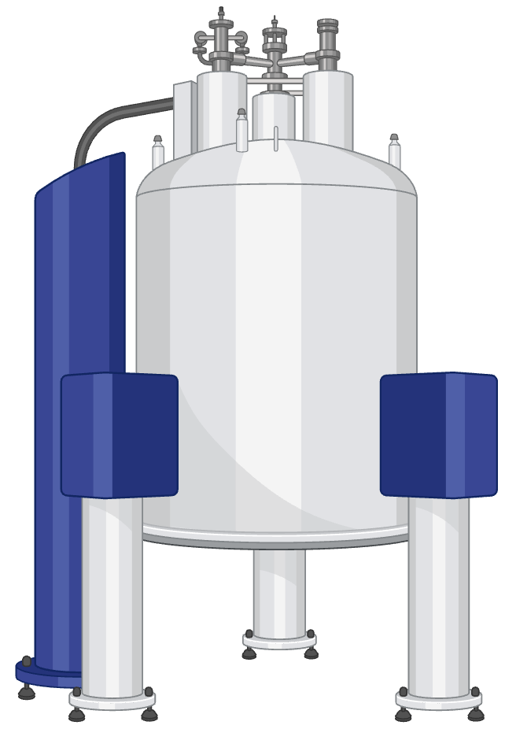
NMR

Slide 2
Plan for today’s exercise session
Recap 15 min
Your Turn
Exercise 4
! check if you have 4.7
Solutions 15:15

Slide 3

Web page NMR try for yourself

Slide 4
Sumary I: What does NMR measure?
In NMR we can observe (measure) any nuclei, which has a magnetic moments
Elements with a nuclear spin I ≠ 0 have a magnetic moment and are called “NMR active”
Examples:
¹H
¹³C
¹⁴N
¹⁹F

Slide 5
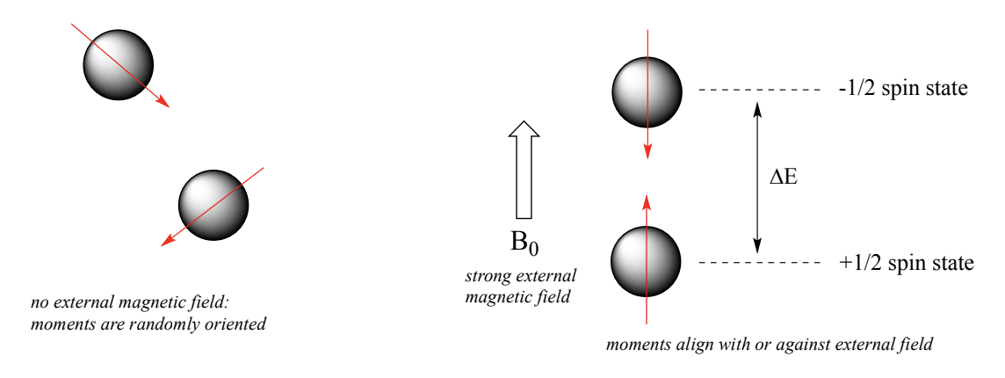
Protons have 2 spin states in B₀
If a magnetic field is applied, protons can orient their spin (= magnetic moment) in 2 ways:
Aligned with B₀ (lower energy, +1/2 state, >50% of protons)
Aligned against B0 (higher energy, -1/2 state, <50% of protons)

Slide 6
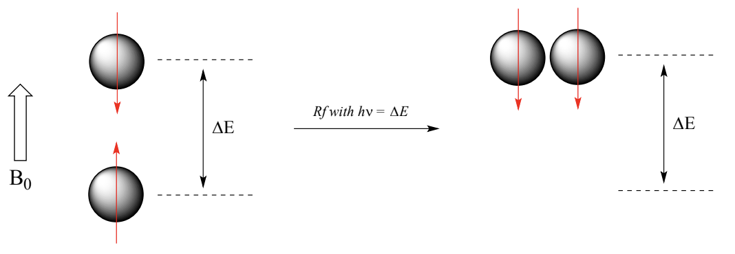
Making Spins flip: Resonance
In NMR we measure the “flipping” (spin transition) of protons from the +1/2 to the -1/2 spin state
For a proton to flip its spin, we need to provide energy to overcome the energy difference between +1/2 and -1/2 state
Rf = radio frequency, h = Planck’s constant, v = frequency of Rf

Slide 7
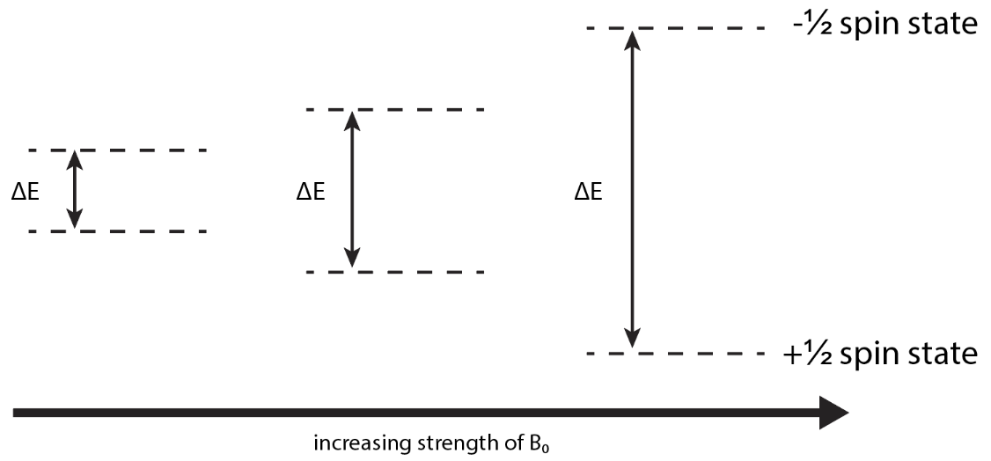
Making Spins flip: Resonance
If we apply a stronger magnetic field B₀, the energy difference (ΔE) between +1/2 and -1/2 spin state increases
In a stronger B₀, we need higher energy (higher frequency) to flip the spins
Stronger B creates better resolution.
If the frequency of the electromagnetic radiation matches the proton’s Larmor frequency (=resonance), the proton can absorb the energy and flip from +1/2 to -1/2
Notes:
Stronger B0 – higher dE – higher vL – better resolution / sensitivity

Slide 8
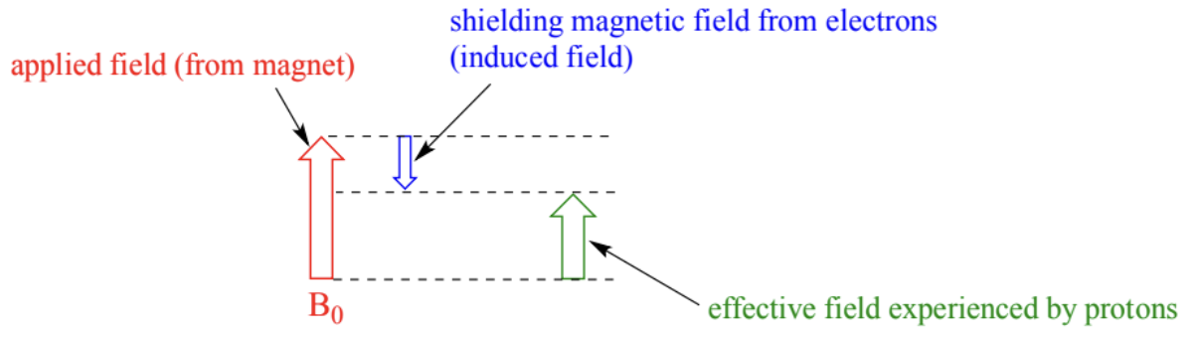
Summary II: Why is not every peak the same?
Electrons create their own magnetic field in B₀ (“induced field”)
The induced field is opposed to B₀
The induced field reduces the magnetic field effectively applied to the nuclei
→ The effective field (and so the resonance frequency and chem. shift) of a nucleus depends on the surrounding electronic environment

Slide 9
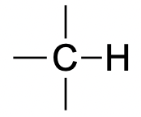

De-shielding occurs due to electronegative atoms
Electron
High electron density
Low electron density
Nucleus
B_{e}
B_{e}
B₀
B_{e}
B₀
B_{eff}
B₀
B_{eff}
Shielding
→ Low chemical shift
De-shielding
→ High chemical shift

Slide 10
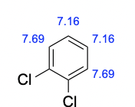
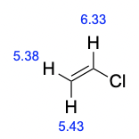
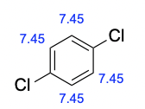
Different chemical environment
Different chemical environment
→ different effective magnetic field
→ different chemical shift
E/Z-Isomerie

Slide 11
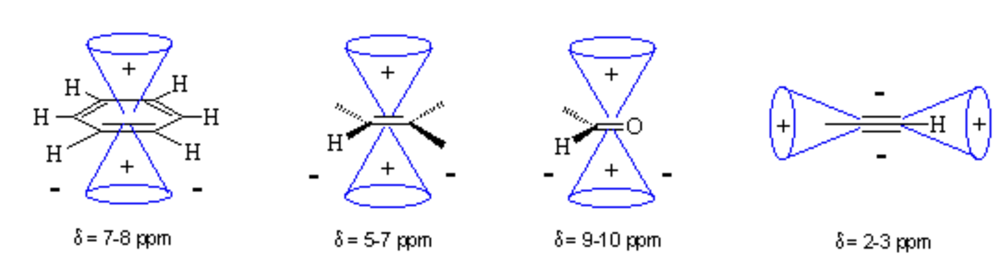
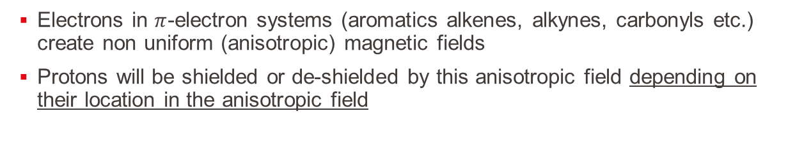
Shielding effects: Non uniform magnetic fields
Electrons in $π$-electron systems (aromatics alkenes, alkynes, carbonyls etc.) create non uniform (anisotropic) magnetic fields
Protons will be shielded or de-shielded by this anisotropic field depending on their location in the anisotropic field
aromatic
alkene
aldehyde
alkyne
+
+
+
-
-
-
+
-
-
+
-
-
+
-
+ = Shielding (low ppm)
- = De-shielding (high ppm)

Slide 12
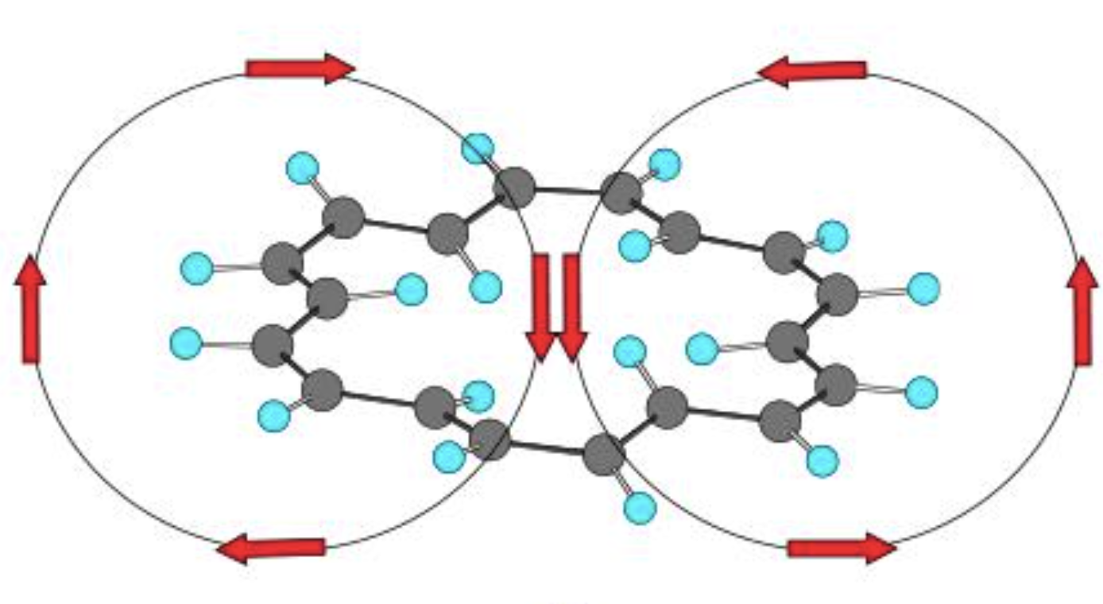

Do Slide on rings
B₀
Anisotropic field induced by
$π$-electrons

Slide 13
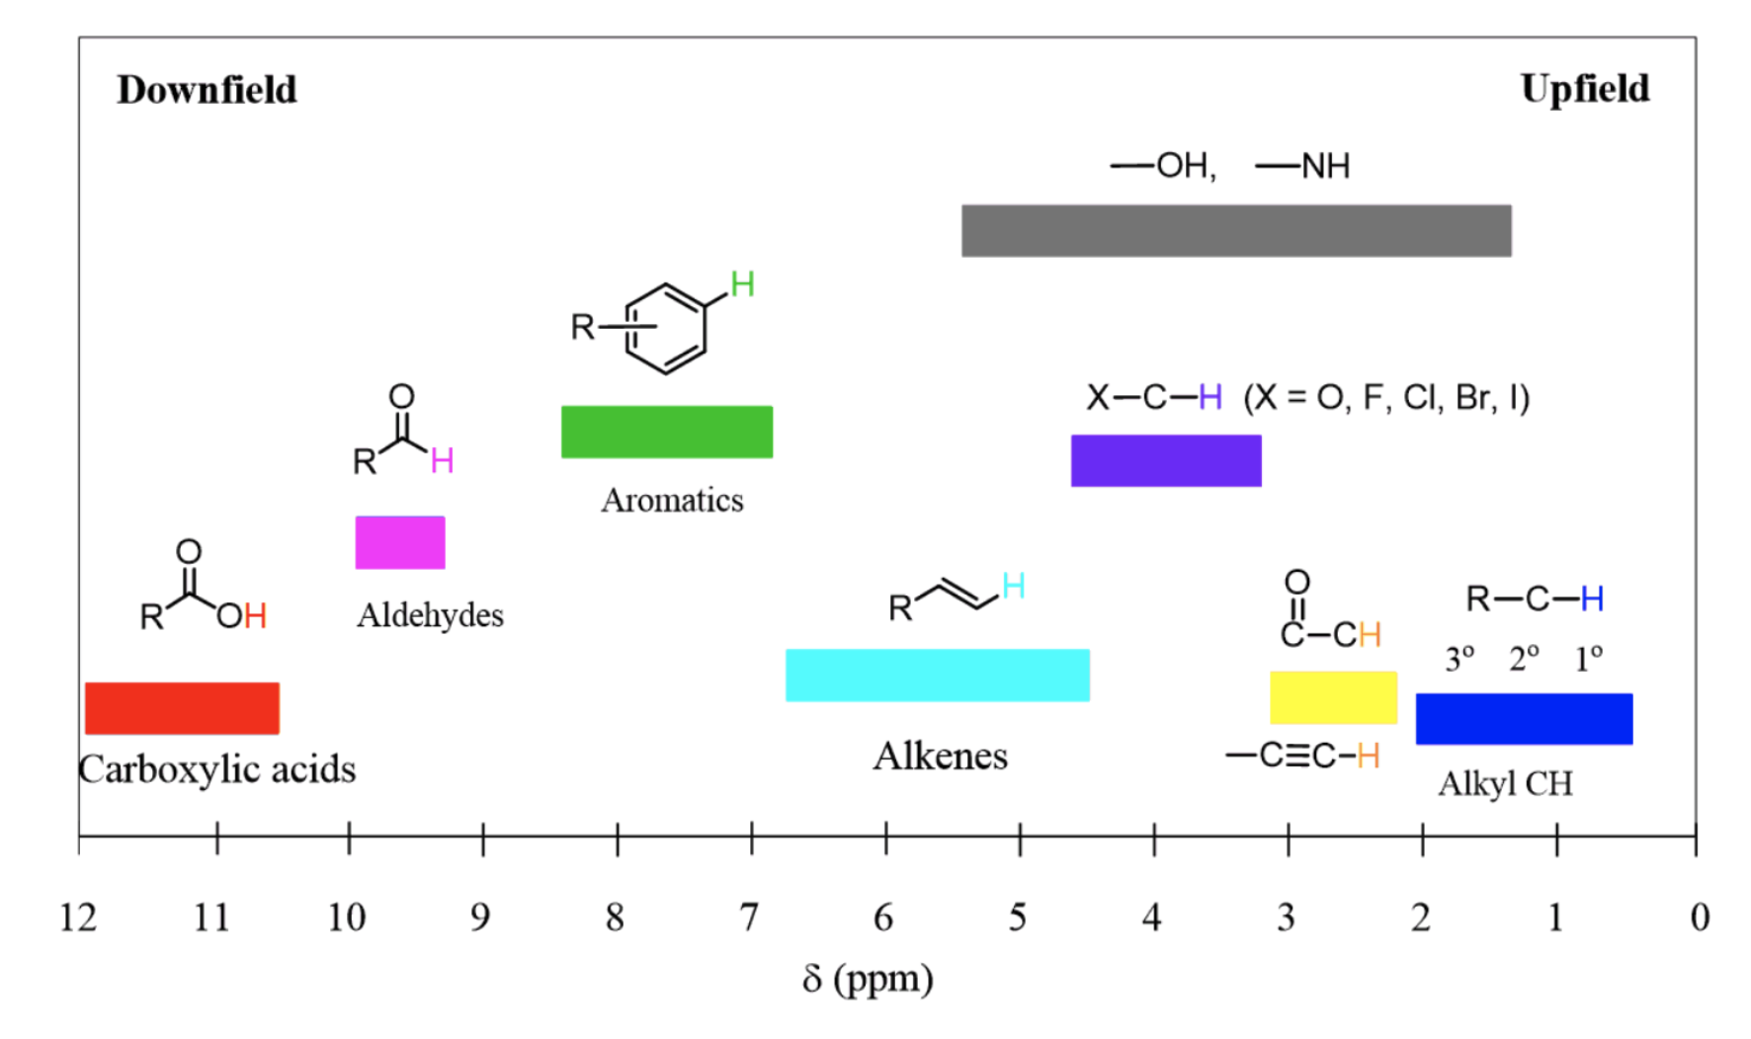
¹H NMR of molecules

Slide 14
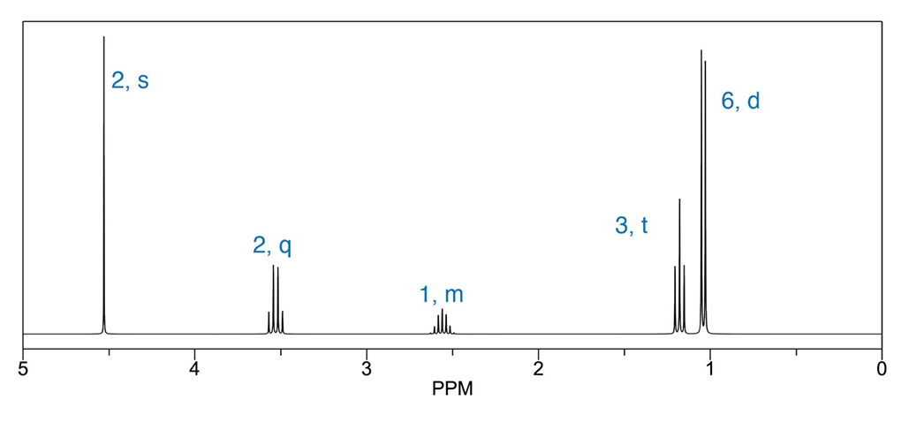
Summary III: What are Spin-Spin interactions:

Slide 15
What are Spin-Spin interactions: Multiplicity
Multiplicity = Splitting
A peak is split into multiple peaks because the proton(s) interact with other protons nearby (coupling of spins)
Multiplicity of signal: n+1 (n = number of close-by protons -> 3 bonds max)
Chemically equivalent protons don’t couple!

Slide 16
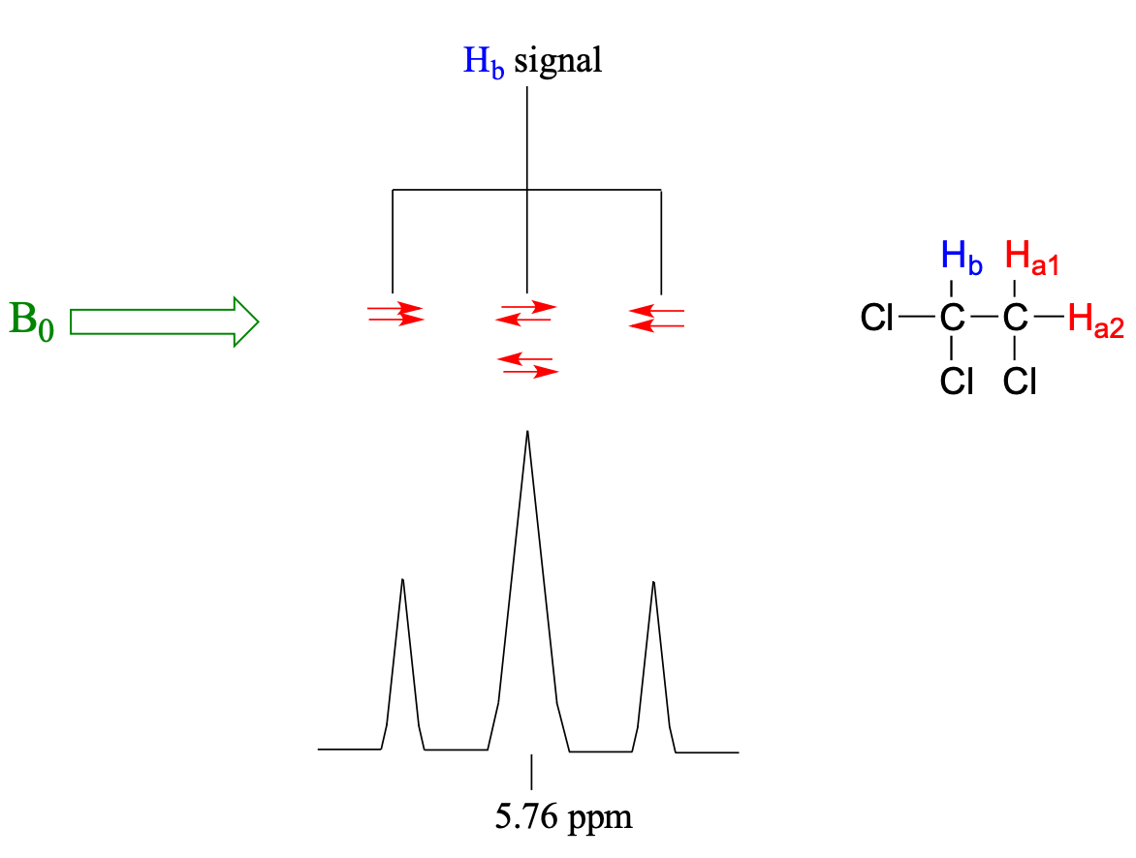
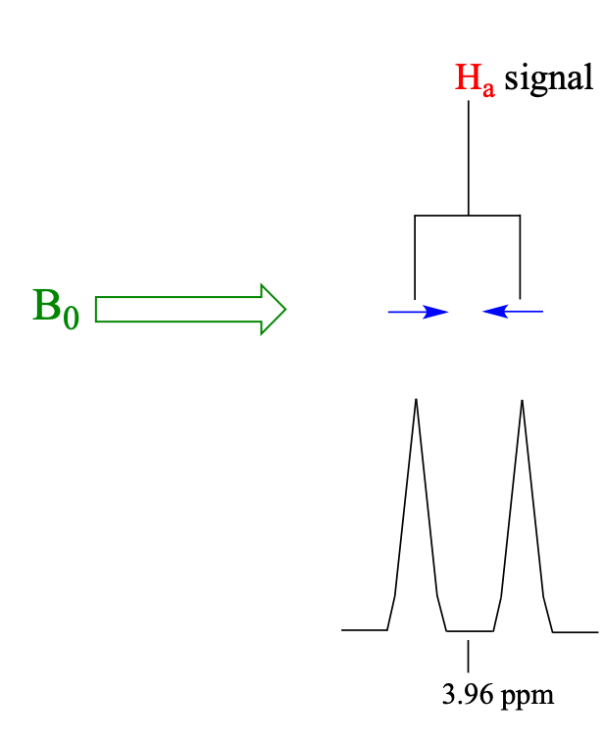
Spin of H_{b} can be
- Aligned with B₀
- Aligned against B₀
→ H_{a} signal will be a doublet
For the H_{a} spins we can form 4 combinations
- Two combinations are magnetically equivalent
→ H_{b} signal will be a triplet

Slide 17
So why do we use NMR
Connectivity of atoms (how atoms are bound together)
Functional groups present

Slide 18
Summary V: What are our tools in analytic chemistry?
C-NMR
H-NMR
IR
U-Vis
MS
Combustion Analysis (Oxygen does not show!)
IHD: Index of hydrogen Deficiency

Slide 19
Solutions Exercise 4

Slide 20
4.0
MS
Combustion Analysis
IHD
IR
U-Vis
NMR

Slide 21
4.1
It is a giant magnet (fun fact it can also affect certain colors used for Tattoos)
I not equal to 0 (we need a magnetic moment)
Peak at 0 is caused by the hydrogens of TMS (reference compound) since depending on the strength of the magnet we have different shifts we must measure relative shift (ppm)

Slide 22
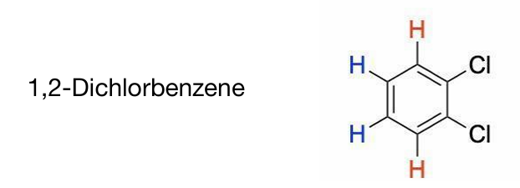
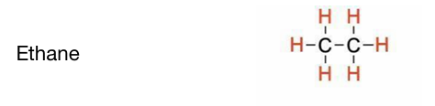
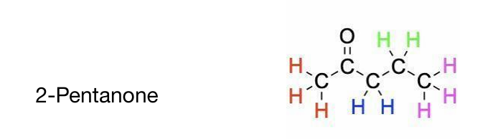
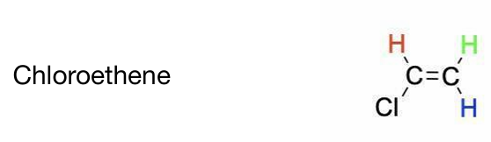
4.2a) different chemical environment
Different chemical environment
→ different effective magnetic field
→ different chemical shift

Slide 23
4.2b) Electrons: Shielding effects
Electrons create their own magnetic field in B₀ (“induced field”)
The induced field is opposed to B₀
The induced field reduces the magnetic field effectively applied to the nuclei
→ The effective field (and so the resonance frequency and chem. shift) of a nucleus depends on the surrounding electronic environment

Slide 24
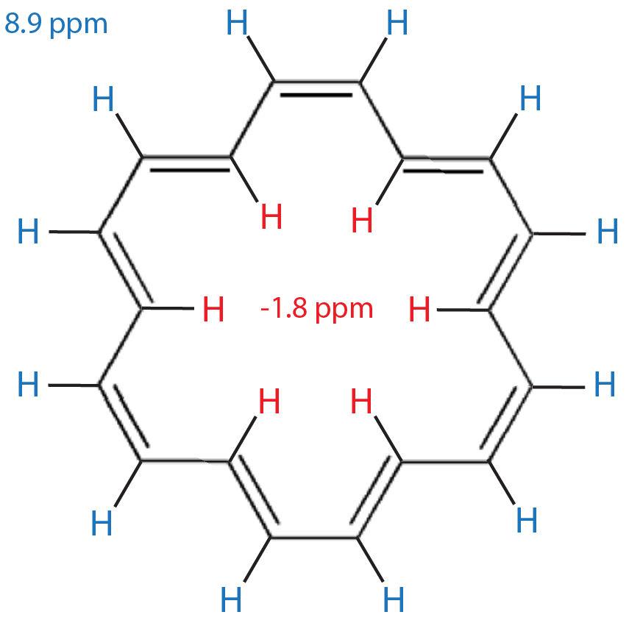

4.2c) [18]-Annulene: anisotropy
B₀
Anisotropic field induced by
$π$-electrons

Slide 25
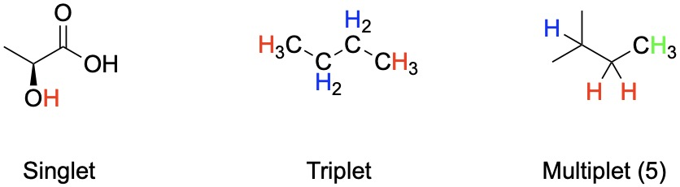
4.3 Multiplicity
No Doublet!
→ O prevents coupling

Slide 26
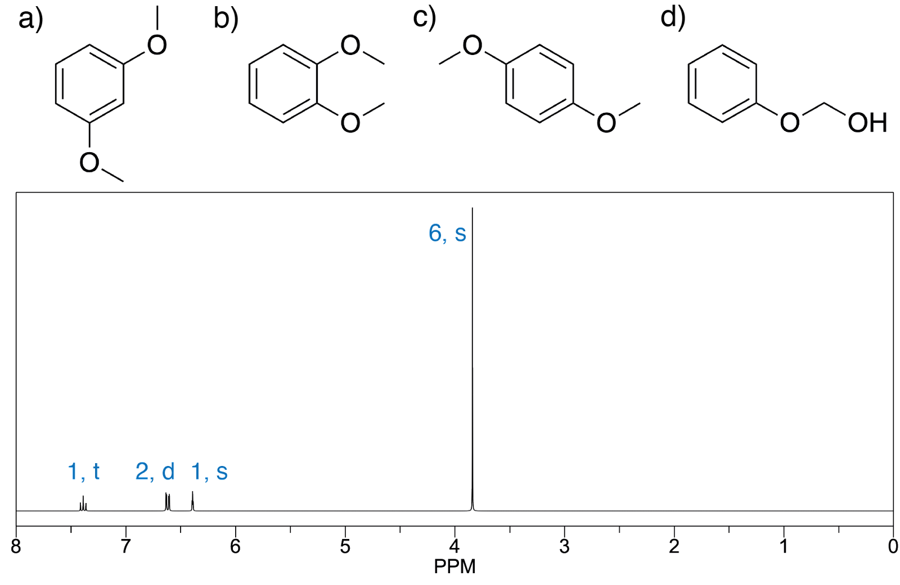
4.4 ¹H NMR of molecules I)

Slide 27
4.4 ¹H NMR of molecules I)
6, s --> six protons with no neighbours and oxygen bound

Slide 28
4.4 ¹H NMR of molecules I)
6, s --> six protons with no neighbours and oxygen bound
1, s --> one proton with no neighbours
2, d --> two protons with one neighbour
1, t --> one proton with two neighbours

Slide 29
4.4 ¹H NMR of molecules I)

Slide 30
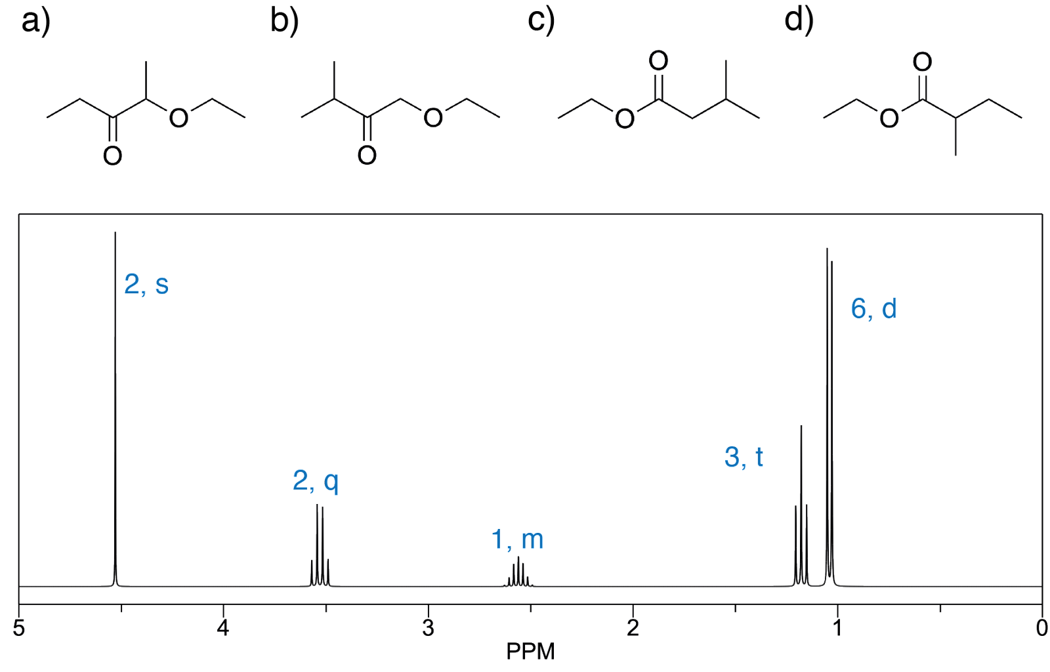
4.4 ¹H NMR of molecules II)
2, s --> two protons with no neighbours and oxygen bound

Slide 31
4.4 ¹H NMR of molecules II)
2, s --> two protons with no neighbours and oxygen bound
6,d --> 6 protons with a single neighbour
3, t --> 3 protons with two neighbours
1, m --> 1 proton with a lot of neighbours (usually more than 4)
2, q --> 2 protons with three neighbours and oxygen bound

Slide 32
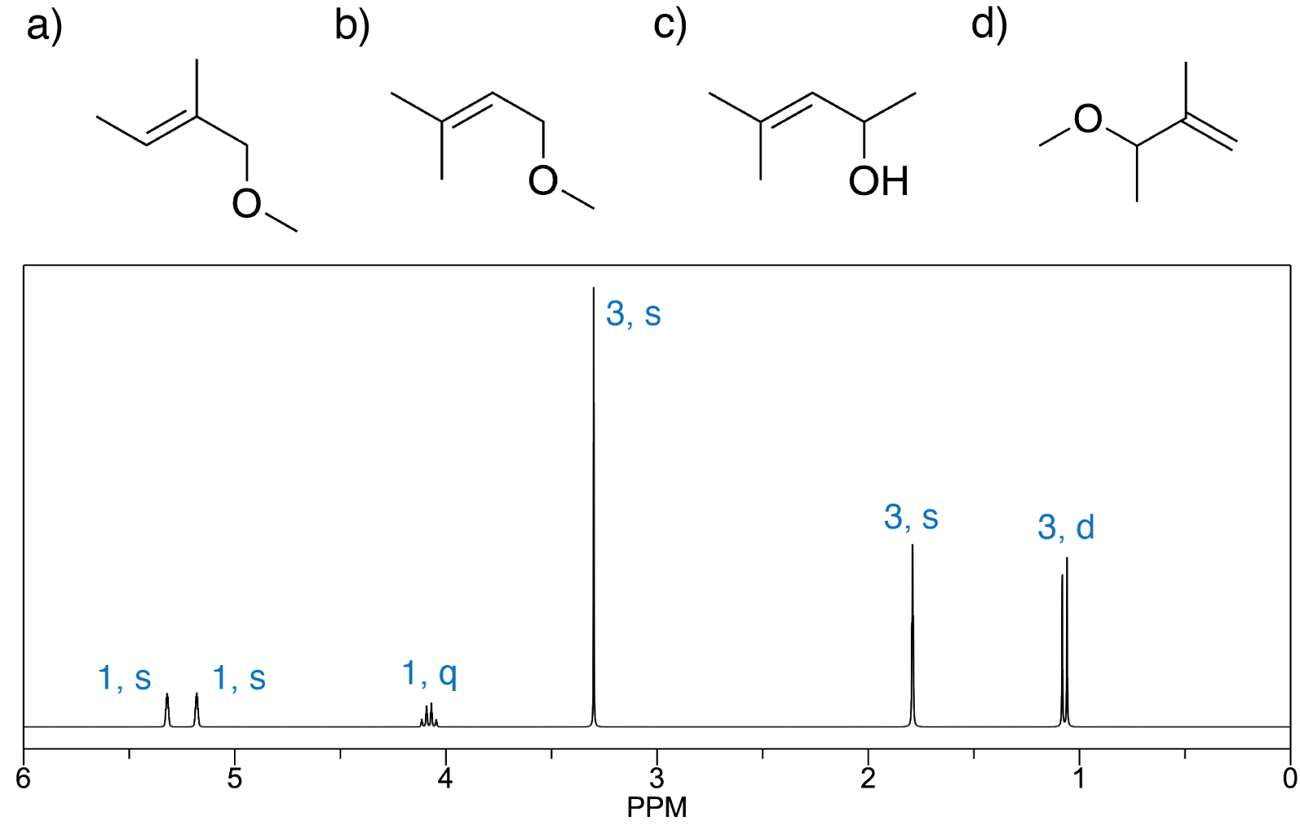
4.4 ¹H NMR of molecules III)
1, s with no neighbours. Is an alkene (left)
1, s with no neighbours. Is an alkene (right)

Slide 33
4.4 ¹H NMR of molecules III)
1, s with no neighbours. Is an alkene (left)
1, s with no neighbours. Is an alkene (right)
3, s --> 3 protons with no neighbours
3, s --> 3 protons with no neighbour and oxygen bound
3, d --> 3 protons with one neighbour
1, q --> one proton with three neighbours and oxygen bound

Slide 34
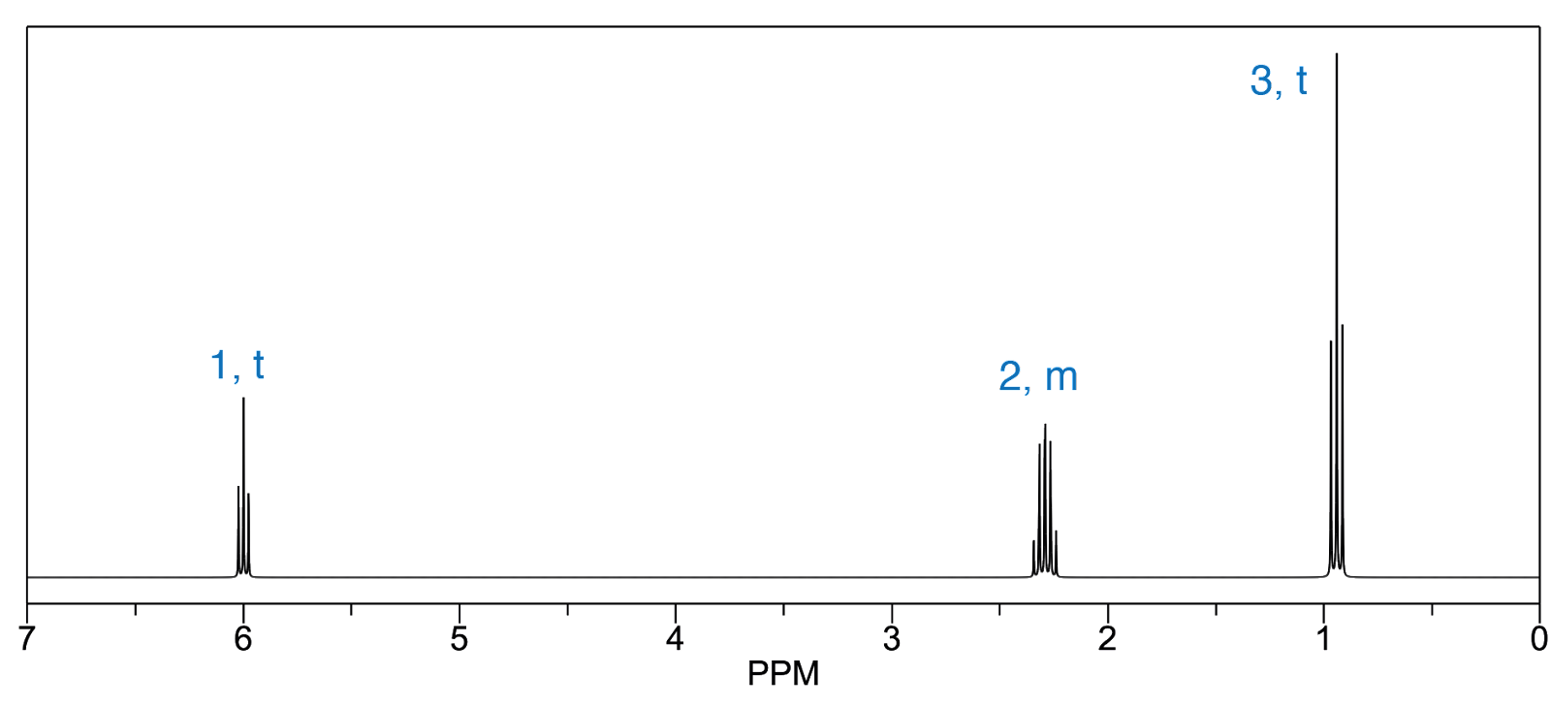
4.5 ¹H NMR structures I) C₃Br₂H₆
3, t --> three protons attached to a carbon (methyl) with two neighbours
2, m --> carbon with two protons and a lot of neighbours
1, t --> one proton with two neighbours. Lots of electron deshielding (more than one Br group attached to carbon)

Slide 35
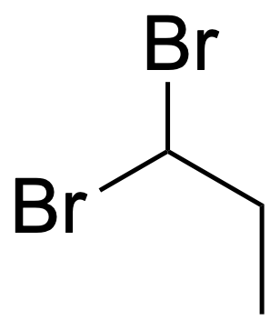
4.5 ¹H NMR structures I) C₃Br₂H₆
3, t --> three protons attached to a carbon (methyl) with two neighbours
2, m --> carbon with two protons and a lot of neighbours
1, t --> one proton with two neighbours. Lots of electron deshielding (more than one Br group attached to carbon)

Slide 36
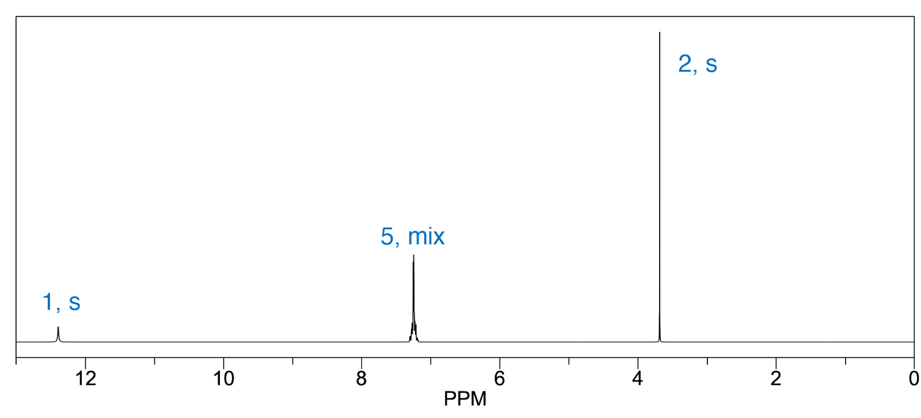
4.5 ¹H NMR structures II) C₈H₈O₂
1, s --> one proton on a carboxylic acid
5, mix --> a lot of protons with similar electronshielding
2, s --> two protons with no neighbours

Slide 37
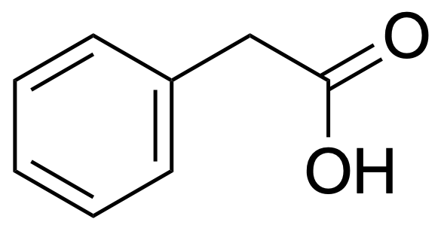
4.5 ¹H NMR structures II) C₈H₈O₂
1, s --> one proton on a carboxylic acid
5, mix --> a lot of protons with electronshielding of an aromatic ring.
2, s --> two protons with no neighbours

Slide 38
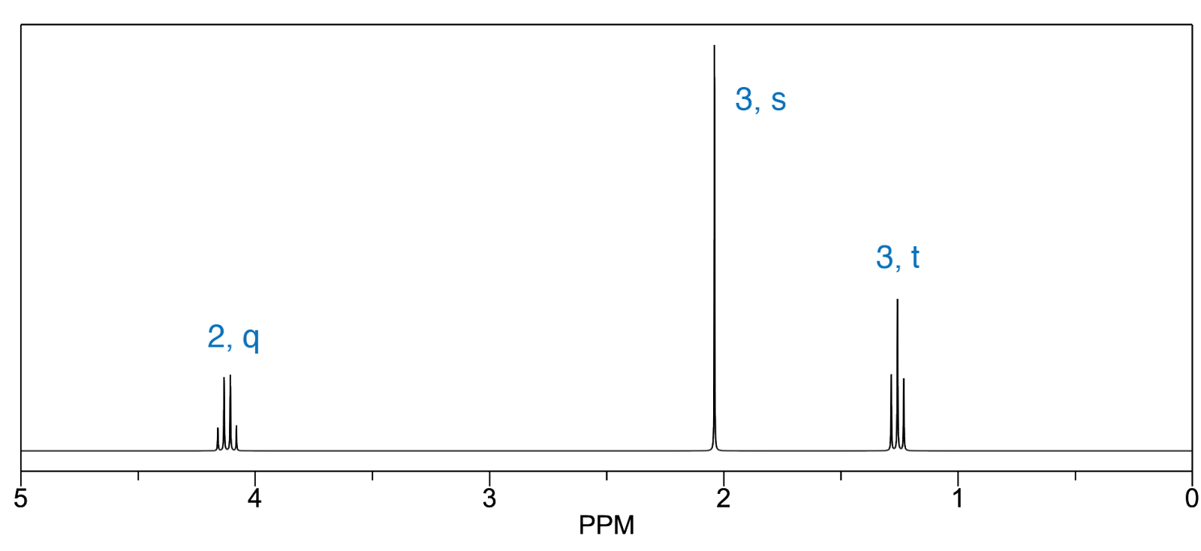
4.5 ¹H NMR structures III) C₄O₂H₈
2, q --> two protons with three neighbours attached to an oxygen
3, s --> three protons with no neighbours
3, t --> three protons with with two neighbours

Slide 39
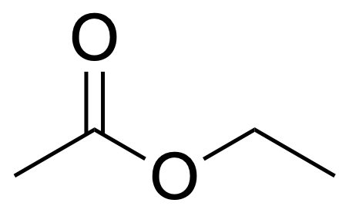
4.5 ¹H NMR structures III) C₄O₂H₈
2, q --> two protons with three neighbours attached to an oxygen
3, s --> three protons with no neighbours
3, t --> three protons with with two neighbours

Slide 40
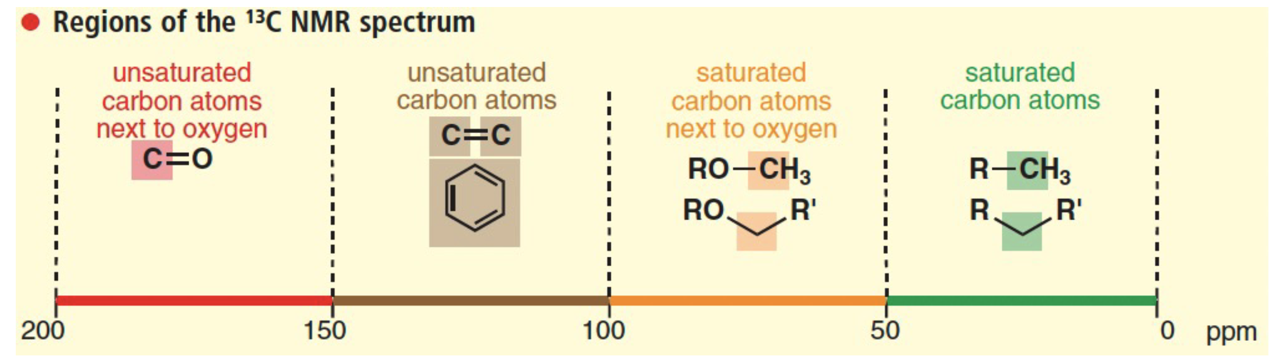
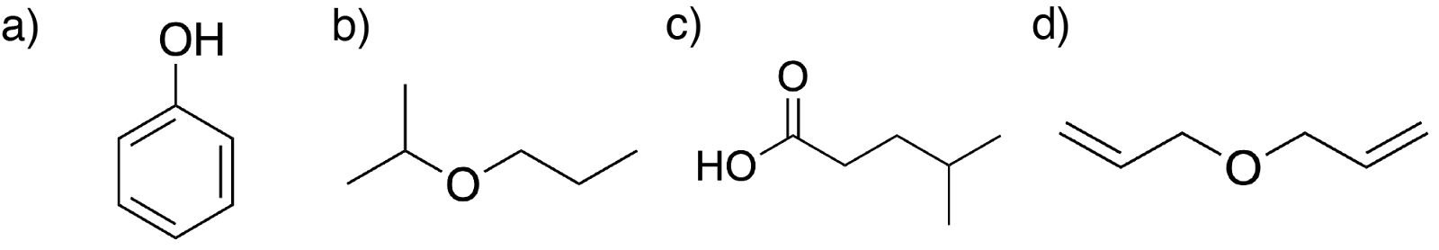
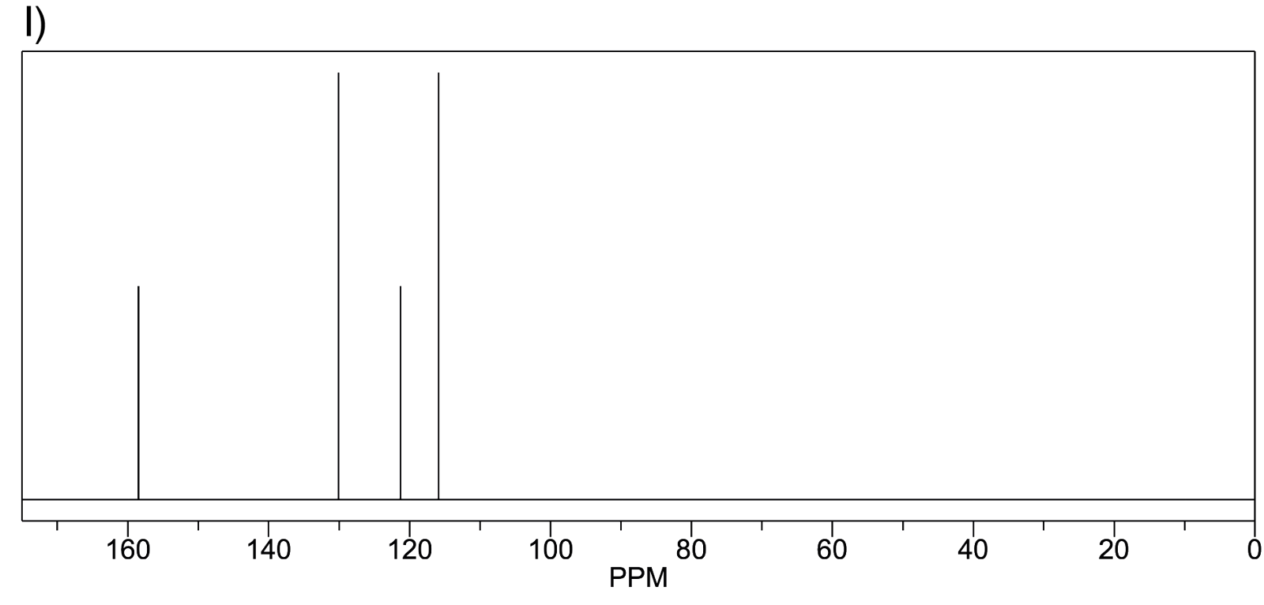
4.6 ¹H NMR structures
160 PPM --> one unsaturated carbon atom
130 PPM --> two equivalent unsaturated carbon atoms
120 PPM --> one unsaturated carbon atom
115 PPM --> two unsaturated carbon atoms

Slide 41
4.6 ¹H NMR structures
160 PPM --> one unsaturated carbon atom
130 PPM --> two equivalent unsaturated carbon atoms
120 PPM --> one unsaturated carbon atom
115 PPM --> two unsaturated carbon atoms

Slide 42
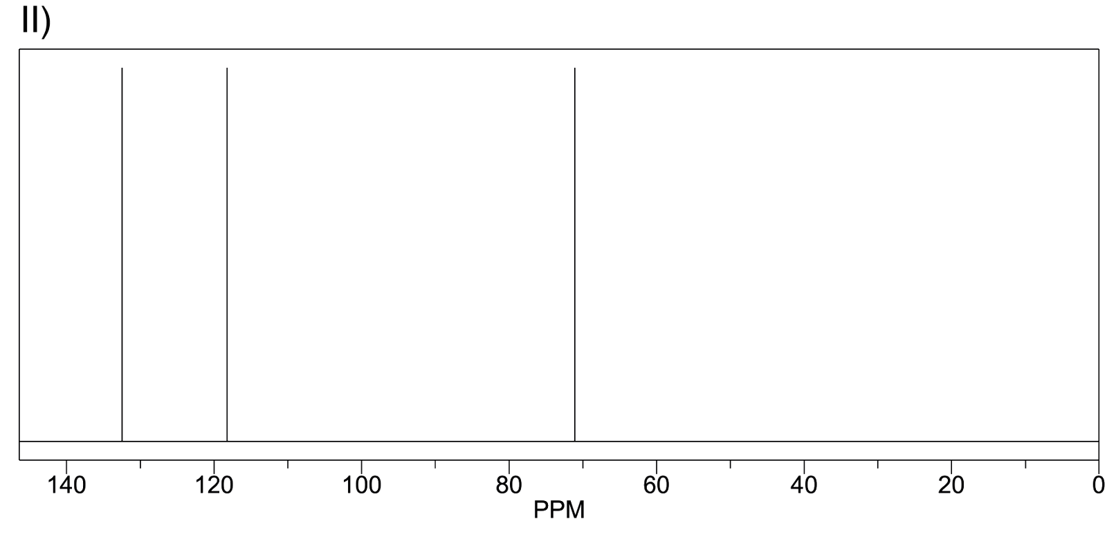
4.6 ¹H NMR structures
130 PPM --> unsaturated carbon atom(s)
120 PPM --> unsaturated carbon atom(s)
70 PPM --> saturated carbon atom next to oxygen

Slide 43
4.6 ¹H NMR structures
130 PPM --> unsaturated carbon atom(s)
120 PPM --> unsaturated carbon atom(s)
70 PPM --> saturated carbon atom next to oxygen

Slide 44
4.6 ¹H NMR structures
130 PPM --> unsaturated carbon atom(s)
120 PPM --> unsaturated carbon atom(s)
70 PPM --> saturated carbon atom next to oxygen

Slide 45
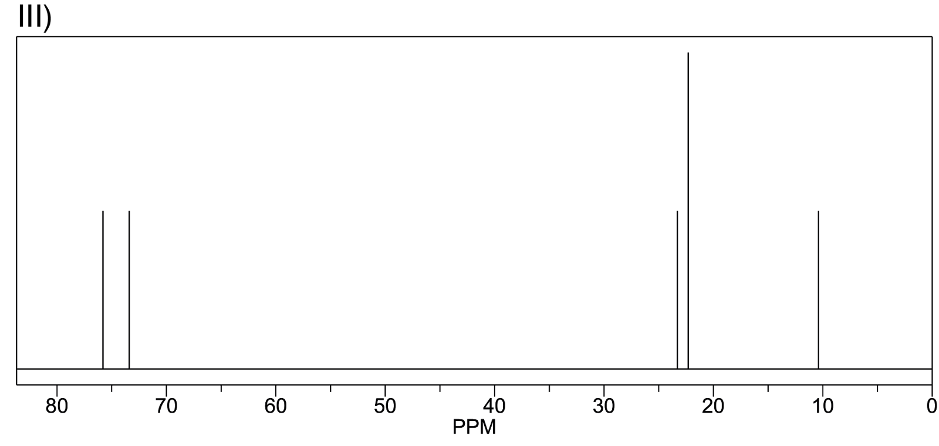
4.6 ¹H NMR structures
76 PPM --> saturated carbon next to oxygen
74 PPM --> saturated carbon next to oxygen
23 PPM --> unsaturated carbon
24 PPM --> two unsaturated carbon atoms
10 PPM --> unsaturated carbon

Slide 46
4.6 ¹H NMR structures
76 PPM --> saturated carbon next two oxygen
74 PPM --> saturated carbon next to oxygen
23 PPM --> unsaturated carbon
24 PPM --> two unsaturated carbon atoms
10 PPM --> unsaturated carbon

Slide 47
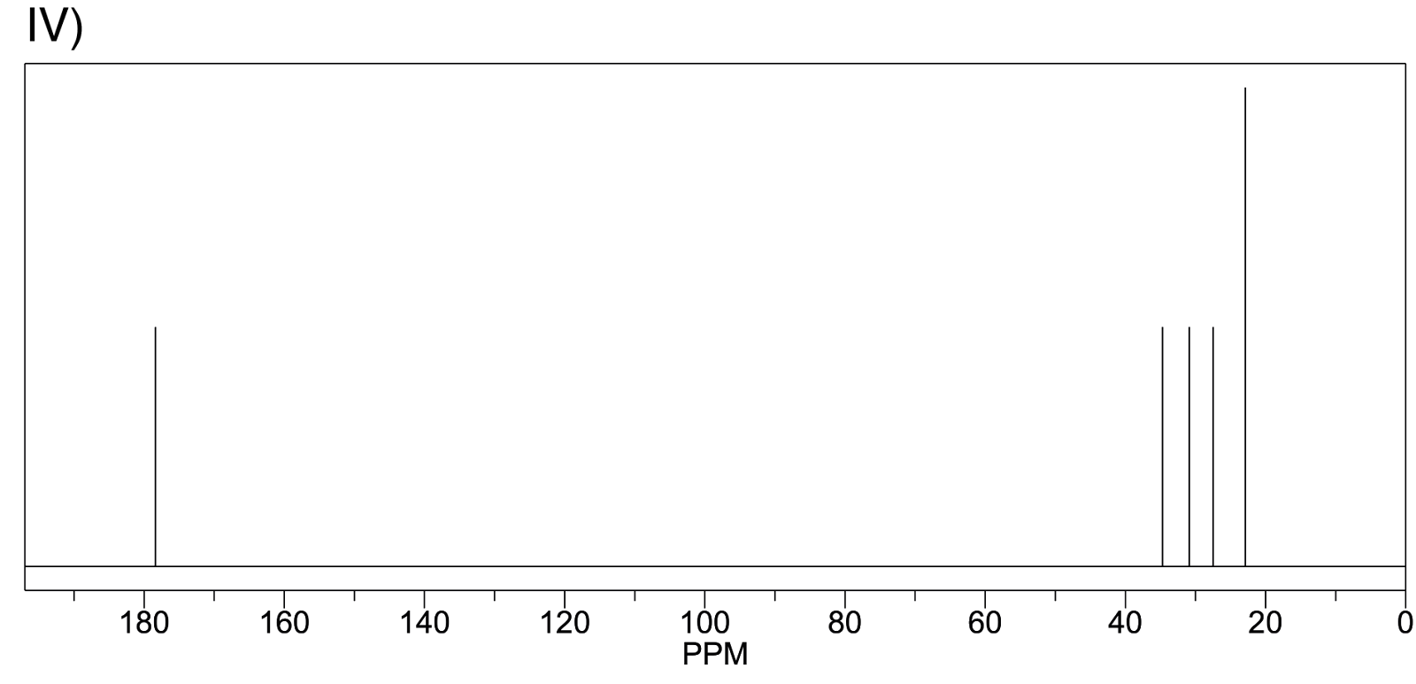
4.6 ¹H NMR structures
180 PPM --> unsaturated carbon next to oxygen
35 PPM --> saturated carbon
30 PPM --> saturated carbon
28PPM --> saturated carbon
23 PPM --> two equivalent saturated carbon atoms

Slide 48
4.6 ¹H NMR structures
180 PPM --> unsaturated carbon next to oxygen
35 PPM --> saturated carbon
30 PPM --> saturated carbon
28PPM --> saturated carbon
23 PPM --> two equivalent saturated carbon atoms

Slide 49
4.7 Puzzle a) Determine Formula
Molecular weight: 88
C: 68.2% -> 88*0.682 -> 5 Carbons
H: 13.6% -> 88*0.136 -> 12 Hydrogens
O: 100% - 68.2% - 13.6% - - - > 1 Oxygen
C5H12O

Slide 50
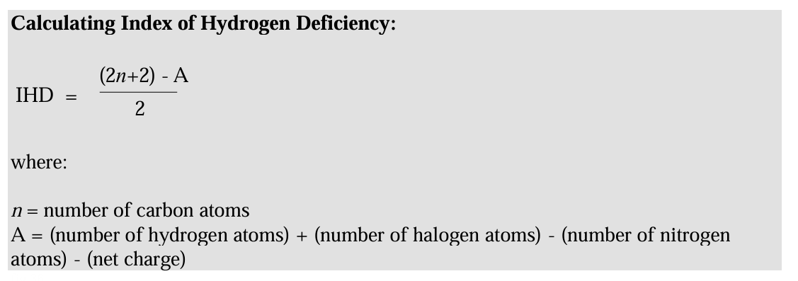
4.7 Puzzle a) IHD = 0

Slide 51
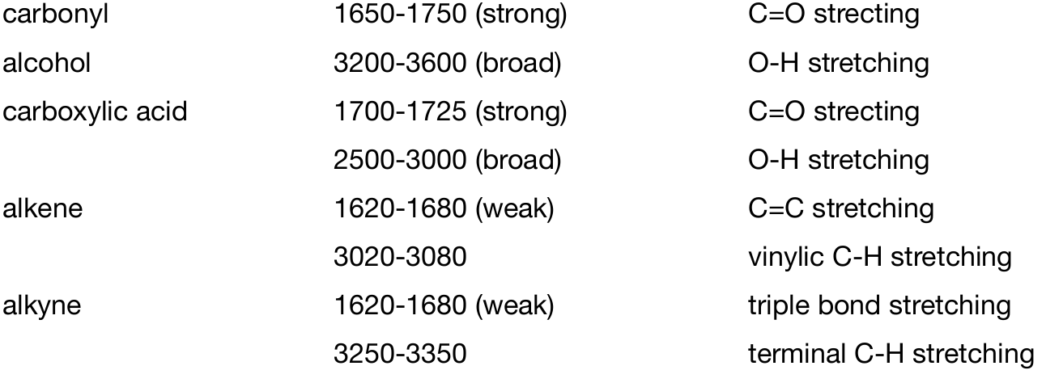
4.7 Puzzle a) alcohol

Slide 52
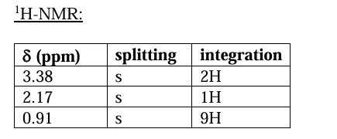
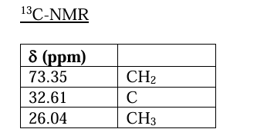
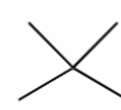
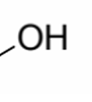
4.7 Puzzle a) H&C - NMR

Slide 53
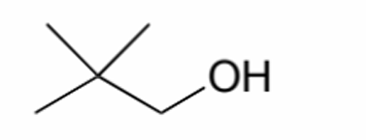
4.7 Puzzle a) Put together
C5H12O
alcohol
no double bonds

Slide 54
4.7 Puzzle b) Determine Formula & HDI
Molecular weight: 88
C: 68.2% -> 88*0.682 -> 5 Carbons
H: 13.6% -> 88*0.136 -> 12 Hydrogens
O: 100% - 68.2% - 13.6% - - - > 1 Oxygen
C10H12O
HDI = 5 (maybe aromatic ring)

Slide 55
4.7 Puzzle a) carbonyl

Slide 56
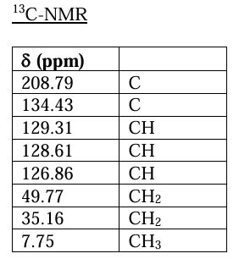
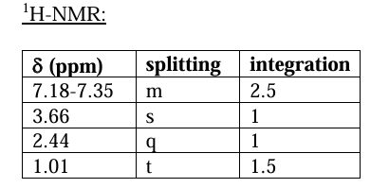
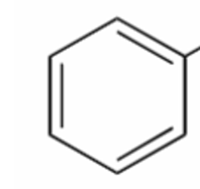

4.7 Puzzle a) H&C - NMR
ketone not aldehyde
aromatic ring

Slide 57
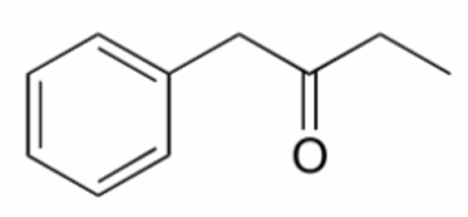
4.7 Puzzle b) Put together
C10H12O
HDI = 5
ketone

Slide 58
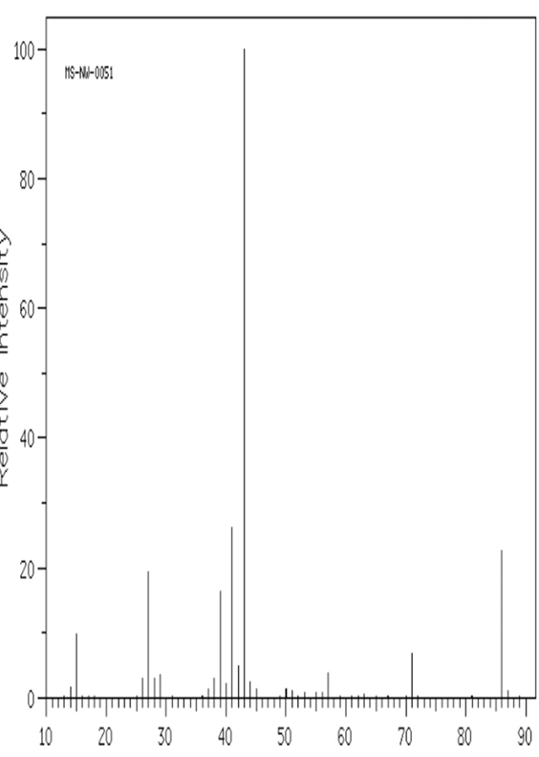
4.7 Puzzle c) Determine Formula & HDI
Molecular weight 86
C: 69.7% -> 5 Carbons
H: 11.7% -> 10 Hydrogens
O: 1 Oxygen
C5H10O
HDI = 1, one double bond.

Slide 59
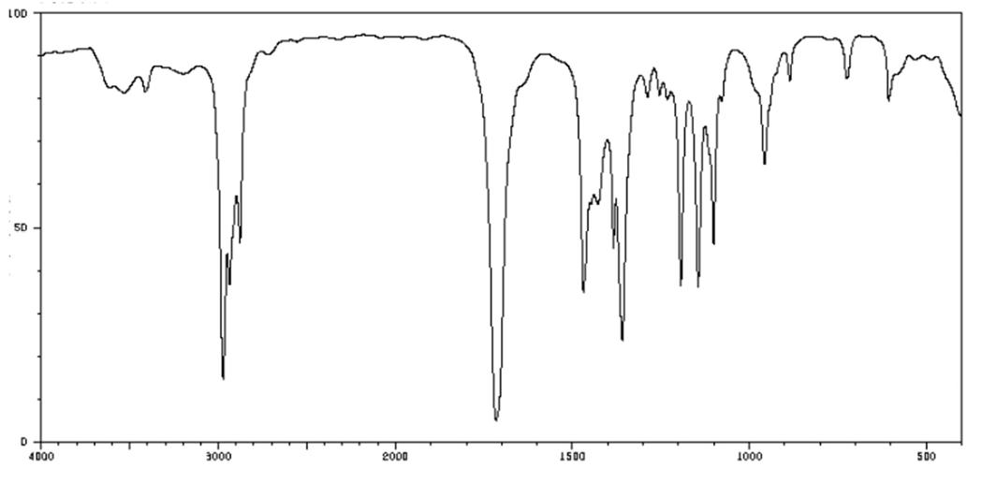
4.7 Puzzle a) IR
carbonyl
not an alcohol

Slide 60





4.7 Puzzle a) H&C - NMR

Slide 61

4.7 Puzzle c) Put together
C5H10O
HDI = 1
ketone

Slide 62
Nice Weekend

